Slide 1


Primitives, Objects, and Heap/Stack
Primitives, Objects and Traces

Slide 2
Primitives and Objects
Primitives: int, double, boolean, char,…
Objects: GRect, GOval, GLine, int[], … (anything with new, and that you call methods on)

Slide 3
Parameters
When passing parameters, make a copy of whatever is on the stack.
Primitives: the actual value is on the stack (pass by value)
Objects: a heap address where the information lives is on the stack. (pass by reference)
Notes:
Arrays are objects! (as are arrays within arrays)

Slide 4
Parameters: Primitives
public void run() { int x = 2;
addTwo(x);
println(x); // x is still 2!
}
private void addTwo(int y) {
y += 2;
}

Slide 5
Parameters: Objects
public void run() { GRect rect = new Grect(0,0,50,50);
fillBlue(rect);
add(rect); // rect is blue!
}
private void fillBlue(GRect rect) {
rect.setFilled(true);
rect.setColor(Color.BLUE);
}

Slide 6
Program Traces
Approaching program traces
Local variables are separate across methods
Parameters are just assigned names by the order in which they’re passed
Write values above variable names as you go through the program (or draw stack frame boxes)
Pass-by-reference vs. pass-by-value

Slide 7
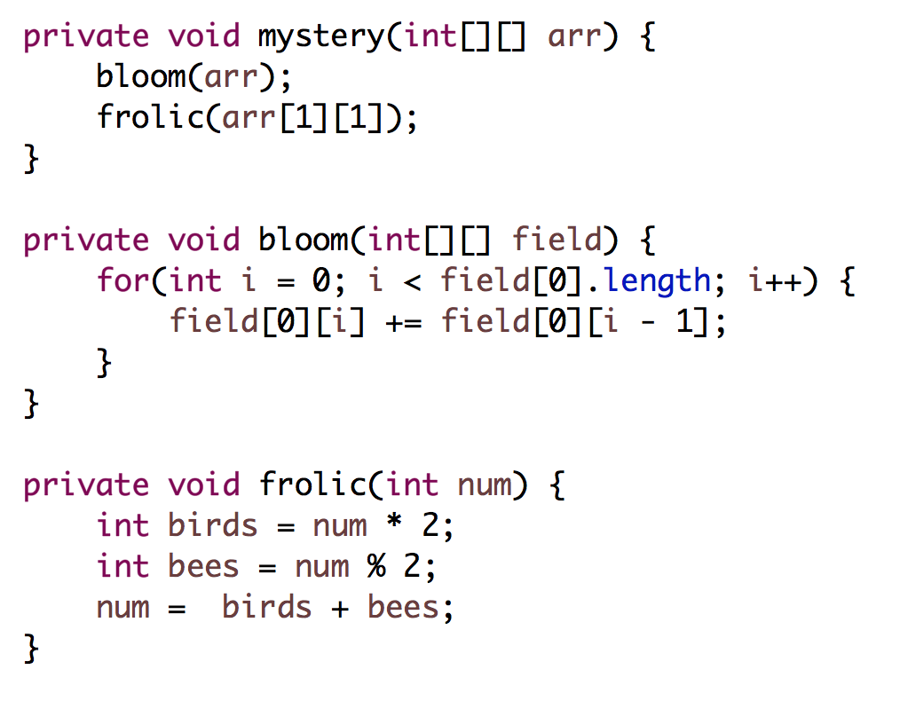
0 | 1 | 2
3 | 4 | 5
Input to mystery()
What is arr after?
Take 1
Notes:
[0, 1, 3]
[3, 4, 5]
8 never returned!

Slide 8
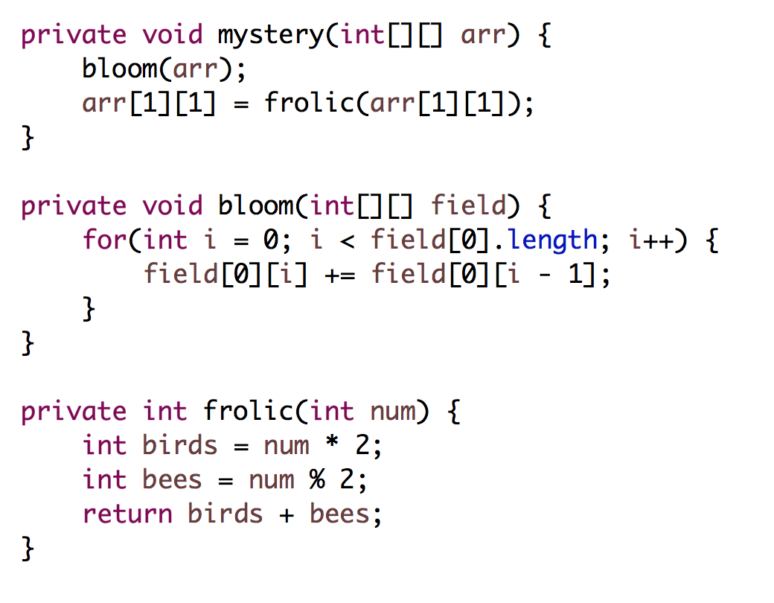
0 | 1 | 2
3 | 4 | 5
Input to mystery()
What is arr after?
Take 2
Notes:
[0, 1, 3]
[3, 8, 5]

Slide 9
Primitives, Objects, and Heap/Stack
Event Drive Programs

Slide 10
Events
Three types of events: keyboard, mouse, interactors
Two ways for Java to execute your code: from run() and from event handlers (mouseClicked, mouseMoved, actionPerformed, etc.)
These programs are asynchronous; your code is not run in order anymore, since you don’t know when the user will interact with your program!

Slide 11
Mouse Events
Sign up for notifications for key or mouse events
Implement the method corresponding to what event you care about (e.g. mousePressed, mouseMoved)
Java will call that method whenever the corresponding event occurs.
Notes:
waitForClick()
e.getX() e.getY()
e.getKeyCode()
e.getKeyChar()

Slide 12
Interactors
Add interactors in init()
addActionListeners() to listen for button presses
.addActionListener(this) on text fields for ENTER
Implement actionPerformed
Java will call actionPerformed whenever an action event occurs.

Slide 13
Interactors
public void actionPerformed(ActionEvent e) {
if (e.getActionCommand().equals(”My Button”)) {
...
}
}
// ... equivalent to ...
public void actionPerformed(ActionEvent e) {
if (e.getSource() == myJButton) {
...
}
}

Slide 14
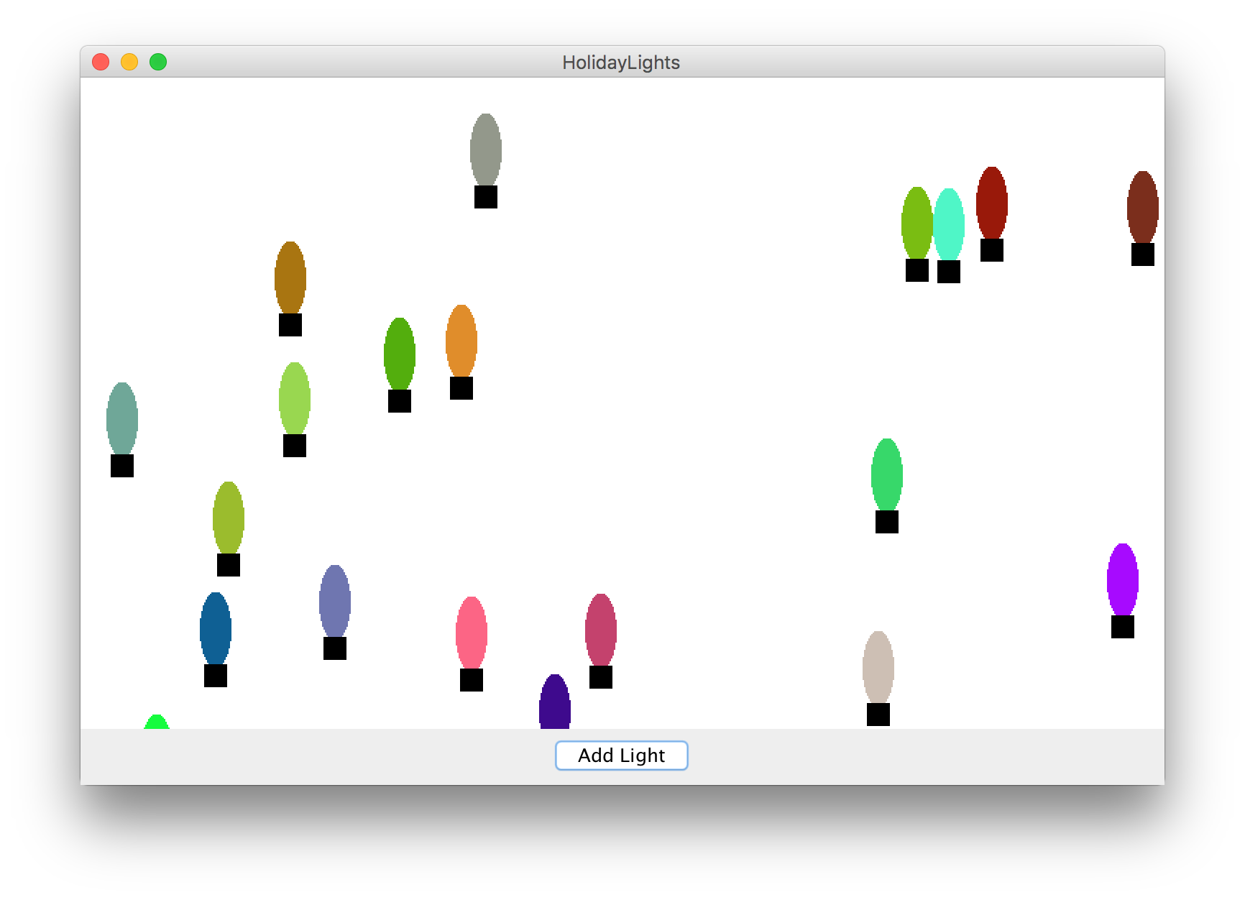
Midsummer’s Night Lights

Slide 15
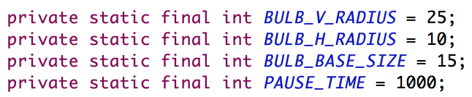
Midsummer’s Night Lights
Add a new light by clicking “Add Light”
Every second, every light on screen changes to a new random color
Notes:
demo

Slide 16
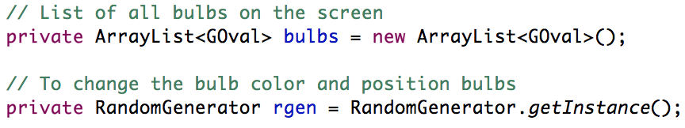
Instance Variables

Slide 17
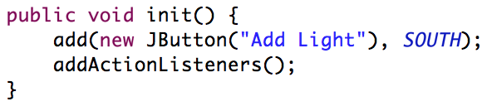
Init()

Slide 18
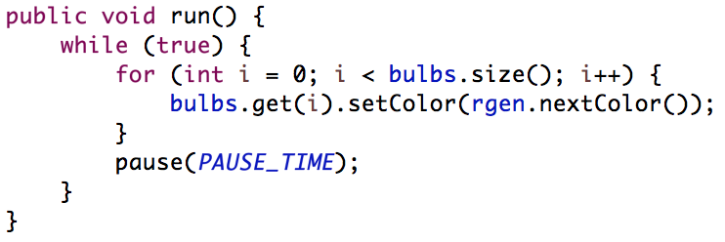
run()

Slide 19
public void actionPerformed(ActionEvent e) {
if (e.getActionCommand().equals("Add Light”)) {
GOval bulb = new GOval(2*BULB_H_RADIUS, 2*BULB_V_RADIUS);
bulb.setFilled(true);
bulb.setColor(Color.RED);
GRect base = new GRect(BULB_BASE_SIZE, BULB_BASE_SIZE);
base.setFilled(true);
base.setColor(Color.BLACK);
int x = rgen.nextInt(0, getWidth());
int y = rgen.nextInt(0, getHeight());
add(bulb, x – BULB_H_RADIUS, y);
add(base, x - BULB_BASE_SIZE / 2.0, y + 2*BULB_V_RADIUS);
bulbs.add(bulb);
}
}

Slide 20
public void actionPerformed(ActionEvent e) {
if (e.getActionCommand().equals("Add Light”)) {
GOval bulb = new GOval(2*BULB_H_RADIUS, 2*BULB_V_RADIUS);
bulb.setFilled(true);
bulb.setColor(Color.RED);
GRect base = new GRect(BULB_BASE_SIZE, BULB_BASE_SIZE);
base.setFilled(true);
base.setColor(Color.BLACK);
int x = rgen.nextInt(0, getWidth());
int y = rgen.nextInt(0, getHeight());
add(bulb, x – BULB_H_RADIUS, y);
add(base, x - BULB_BASE_SIZE / 2.0, y + 2*BULB_V_RADIUS);
bulbs.add(bulb);
}
}

Slide 21
public void actionPerformed(ActionEvent e) {
if (e.getActionCommand().equals("Add Light”)) {
GOval bulb = new GOval(2*BULB_H_RADIUS, 2*BULB_V_RADIUS);
bulb.setFilled(true);
bulb.setColor(Color.RED);
GRect base = new GRect(BULB_BASE_SIZE, BULB_BASE_SIZE);
base.setFilled(true);
base.setColor(Color.BLACK);
int x = rgen.nextInt(0, getWidth());
int y = rgen.nextInt(0, getHeight());
add(bulb, x – BULB_H_RADIUS, y);
add(base, x - BULB_BASE_SIZE / 2.0, y + 2*BULB_V_RADIUS);
bulbs.add(bulb);
}
}

Slide 22
public void actionPerformed(ActionEvent e) {
if (e.getActionCommand().equals("Add Light”)) {
GOval bulb = new GOval(2*BULB_H_RADIUS, 2*BULB_V_RADIUS);
bulb.setFilled(true);
bulb.setColor(Color.RED);
GRect base = new GRect(BULB_BASE_SIZE, BULB_BASE_SIZE);
base.setFilled(true);
base.setColor(Color.BLACK);
int x = rgen.nextInt(0, getWidth());
int y = rgen.nextInt(0, getHeight());
add(bulb, x – BULB_H_RADIUS, y);
add(base, x - BULB_BASE_SIZE / 2.0, y + 2*BULB_V_RADIUS);
bulbs.add(bulb);
}
}

Slide 23
public void actionPerformed(ActionEvent e) {
if (e.getActionCommand().equals("Add Light”)) {
GOval bulb = new GOval(2*BULB_H_RADIUS, 2*BULB_V_RADIUS);
bulb.setFilled(true);
bulb.setColor(Color.RED);
GRect base = new GRect(BULB_BASE_SIZE, BULB_BASE_SIZE);
base.setFilled(true);
base.setColor(Color.BLACK);
int x = rgen.nextInt(0, getWidth());
int y = rgen.nextInt(0, getHeight());
add(bulb, x – BULB_H_RADIUS, y);
add(base, x - BULB_BASE_SIZE / 2.0, y + 2*BULB_V_RADIUS);
bulbs.add(bulb);
}
}

Slide 24
public void actionPerformed(ActionEvent e) {
if (e.getActionCommand().equals("Add Light”)) {
GOval bulb = new GOval(2*BULB_H_RADIUS, 2*BULB_V_RADIUS);
bulb.setFilled(true);
bulb.setColor(Color.RED);
GRect base = new GRect(BULB_BASE_SIZE, BULB_BASE_SIZE);
base.setFilled(true);
base.setColor(Color.BLACK);
int x = rgen.nextInt(0, getWidth());
int y = rgen.nextInt(0, getHeight());
add(bulb, x – BULB_H_RADIUS, y);
add(base, x - BULB_BASE_SIZE / 2.0, y + 2*BULB_V_RADIUS);
bulbs.add(bulb);
}
}

Slide 25
public void actionPerformed(ActionEvent e) {
if (e.getActionCommand().equals("Add Light”)) {
GOval bulb = new GOval(2*BULB_H_RADIUS, 2*BULB_V_RADIUS);
bulb.setFilled(true);
bulb.setColor(Color.RED);
GRect base = new GRect(BULB_BASE_SIZE, BULB_BASE_SIZE);
base.setFilled(true);
base.setColor(Color.BLACK);
int x = rgen.nextInt(0, getWidth());
int y = rgen.nextInt(0, getHeight());
add(bulb, x – BULB_H_RADIUS, y);
add(base, x - BULB_BASE_SIZE / 2.0, y + 2*BULB_V_RADIUS);
bulbs.add(bulb);
}
}

Slide 26
public void actionPerformed(ActionEvent e) {
if (e.getActionCommand().equals("Add Light”)) {
GOval bulb = new GOval(2*BULB_H_RADIUS, 2*BULB_V_RADIUS);
bulb.setFilled(true);
bulb.setColor(Color.RED);
GRect base = new GRect(BULB_BASE_SIZE, BULB_BASE_SIZE);
base.setFilled(true);
base.setColor(Color.BLACK);
int x = rgen.nextInt(0, getWidth());
int y = rgen.nextInt(0, getHeight());
add(bulb, x – BULB_H_RADIUS, y);
add(base, x - BULB_BASE_SIZE / 2.0, y + 2*BULB_V_RADIUS);
bulbs.add(bulb);
}
}

